Slide 1
SIGN LANGUAGE RECOGNITION
By : Vikas Thapliyal
Palak

Slide 2
INTRODUCTION
So lets get familiar with the libraries that we’ll be using in this project as well as the dataset
Well, the dataset is a augmented image dataset which has about 3000 images for each American Sign Alphabet,
The libraries we used are open cv, numpy, matplotlib, tensorflow, the API keras..
This project will generally only detect the sign and the alphabet associated with that sign but in future we might like to apply Natural Language Processing in order to predict the sentence completely and use gTTS to convert that text to speech and recite it through the computer..

Slide 3
PROBLEMS
Firstly we all know that using IOT based gloves and other measures such as distance analysis and other IOT based projects slowly get very expensive ..
To overcome this I tried a project which can do the same things as a IOT based maybe even better sometimes using image recognition.
Understanding dumb people through sign language has always been a challenge for an average man…
So the solution to that was using image recognition to create finally an app that can do that for us…

Slide 4
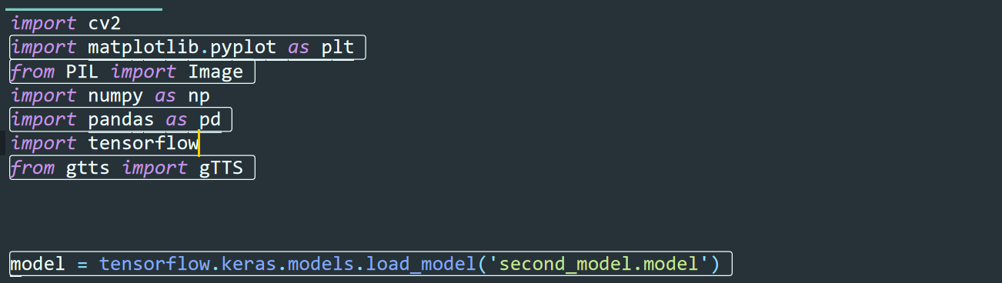
MODULES
The basic functionality of these modules has already been explained above and the load_models is used to load a pre trained model that we created using keras api

Slide 5
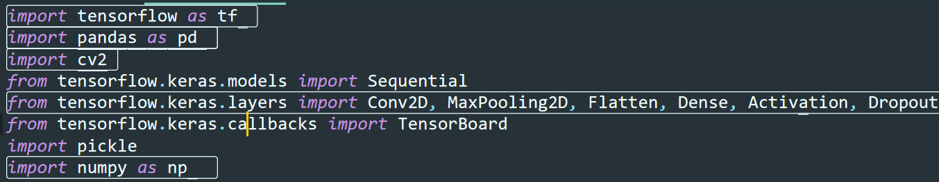
MODULES FOR KERAS

Slide 6
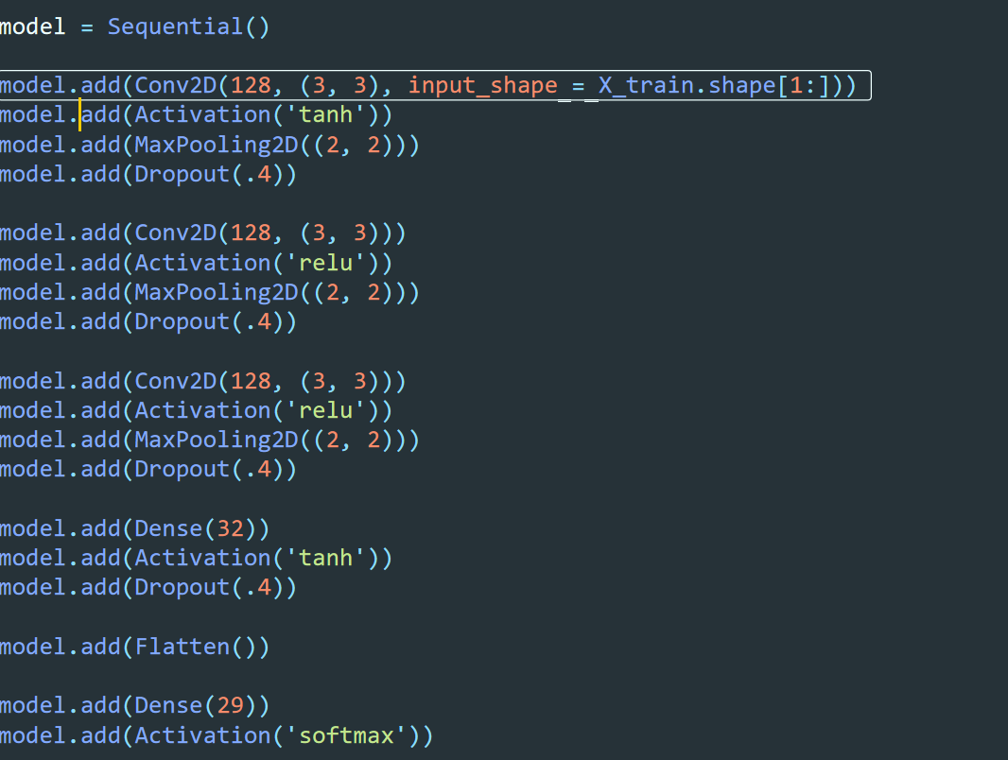
A glimpse of the layers of the model:

Slide 7
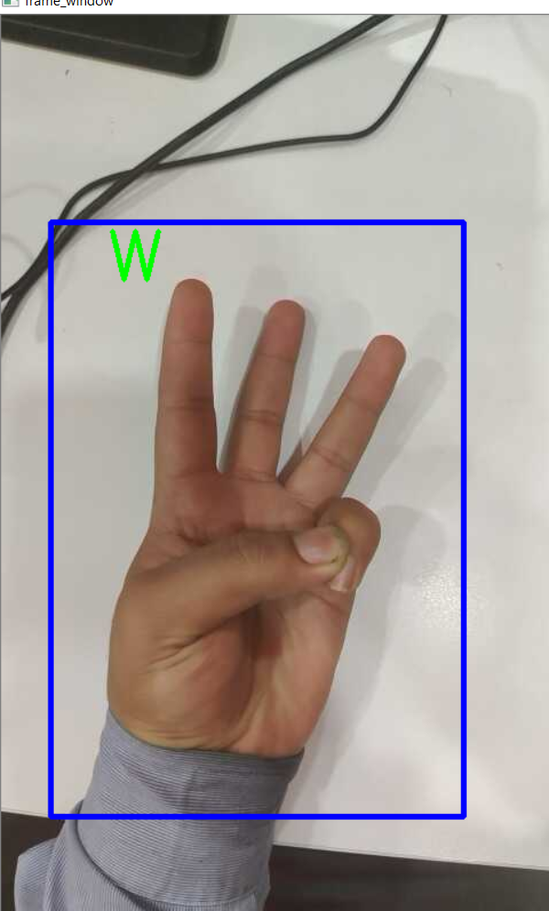
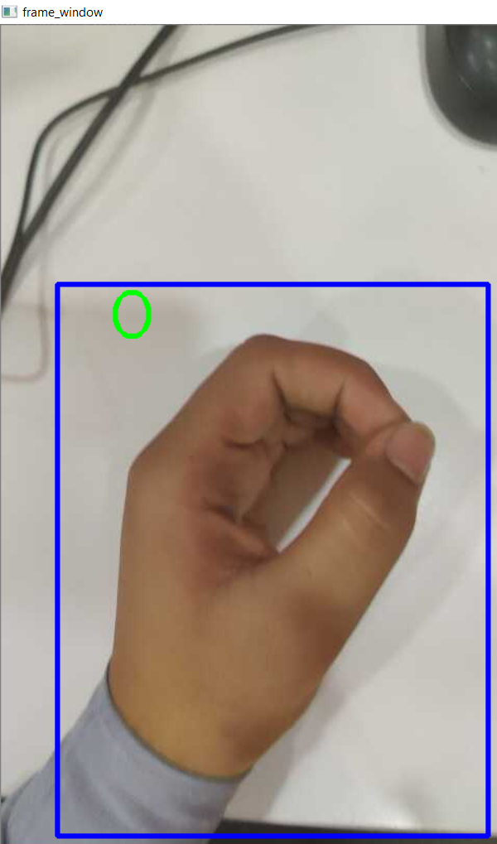
SOME OUTPUTS:

Slide 8
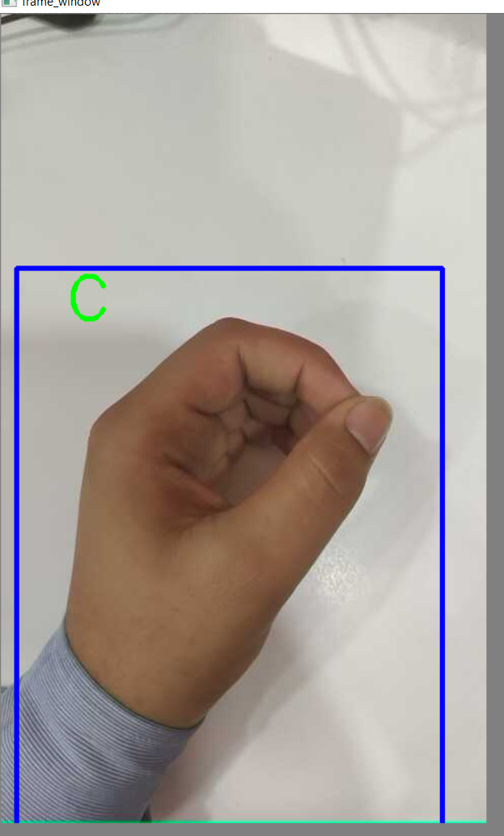
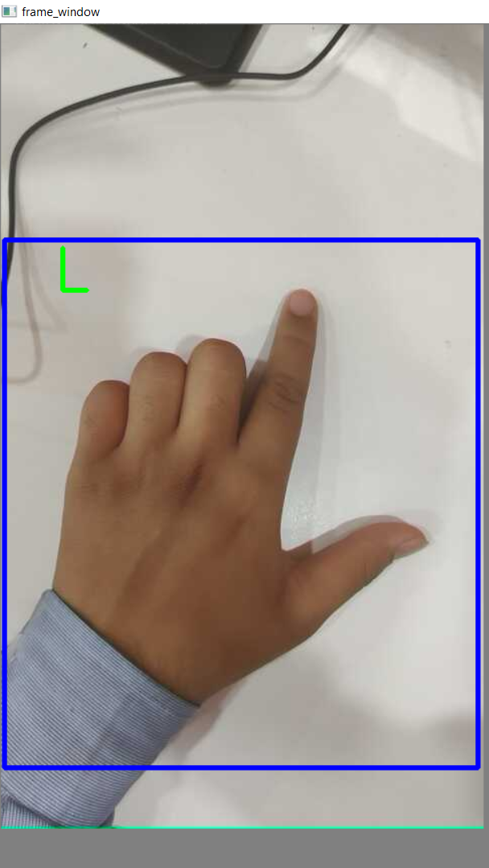

Slide 9
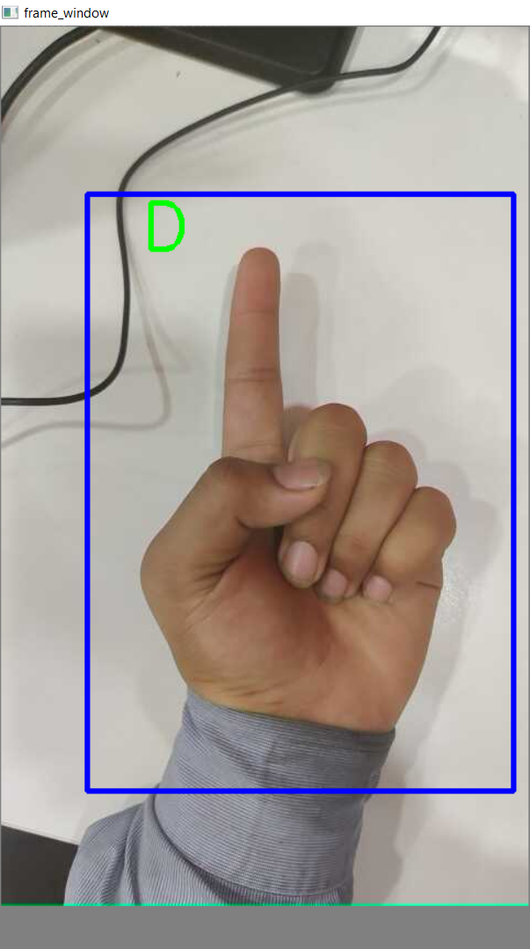

Slide 10
CONCLUSION
Finally this project will be about 40 to 60 % accurate and we would’ve liked to work more on this but the time constraint and the resources at hand constraint did not allowed us to do that…
The data is also overfitting at some point I would also like to take care of that which is a long hit and trial process.

